Slide 1
111 Criteria for Approval # 6
Monitoring for Safety Plan

Slide 2
Belmont Report & 45 CFR 46.111 & 21 CFR 56.111
Risks minimized Belmont: Respect for Persons & Beneficence
Favorable risk : benefit ratio Belmont: Respect for Persons & Beneficence
Equitable selection of subjects Belmont: Justice
Informed consent sought Belmont: Respect for Persons
Informed consent documented Belmont: Respect for Persons
Monitoring plan for safety Belmont: Beneficence
Privacy & confidentiality protected Belmont: Respect for Persons
Additional safeguards for vulnerable populations Belmont: Respect for Persons,
Beneficence & Justice

Slide 3
Belmont & Safety Plan (Beneficence)
This Photo by Unknown Author is licensed under CC BY-SA

Slide 4
45 CFR 46.111( 6) When appropriate, the research plan makes adequate provision for monitoring the data collected to ensure the safety of subjects.
Why is this necessary?
Is the study on track?
Will it be able to answer the research question?
Will it NOT be able to answer the research questions & need to stop?
Are risk what was anticipated?
Have they changed? Increased in severity &/or frequency?
Are stopping rules in place & appropriate?

Slide 5
How to Monitor & Who Does It ?
Safety Plan should match the risks posed .
Range of options
Data Monitor--independent reviewer
Data Monitoring Committee
Chartered Data Safety Monitoring Board
NOTE: NIH funded trials require a Data & Safety Monitoring Plan & some a DSMB

Slide 6
Scientific Review Committee (SRC)
Review study protocols prior to IRB submission that meet the following:
Greater than minimal risk
Have not received rigorous scientific review
Are not cancer research
Not a local site of a multi-center industry sponsored study
Require submission of a “comprehensive protocol written to accepted industry standards”

Slide 7
The SRC → IRB Relationship and Interface
SRC
Scientific Merit & Importance
Feasibility
Clearly Stated Aims
Relevant Outcome Measures
Appropriate Data Management &
Safety Monitoring Plans
Statistical Integrity
Adherence to GCP, FDA, &
UNC Research Requirements
IRB
Subjectsʼ Rights & Welfare
Ethical Conduct in Research
Appropriate Background & Training of Research Personnel
Transparency Regarding Risks and Benefits of Participation
Equal Opportunity & Parity
Adherence to Federal & State laws, OHRP & UNC Policies
https://research.unc.edu/clinical-trials/src/src-irb/

Slide 8
SRC Review Criteria
Evaluating clinical research studies for scientific merit and integrity
study objective(s) are based on a well-researched background;
there is a strong rationale for the proposed experimental approach;
specific aim(s) are clearly delineated and reasonable in terms of resources and timeframes;
outcome measures of interest are appropriate to achieve study aims;
study intervention, including visit schedules and procedures, are described in detail;
database system and processes for data management/quality are well-planned;
real-time safety monitoring and reporting, including DSMB/DSMC if appropriate, is addressed in detail;
statistical considerations, including sample size calculation and planned statistical methods/tests are described and justified; and
there is a 1:1 match between each study aim, proposed outcomes measure(s) related to that aim, and the statistical analysis plan(s) that will be utilized to obtain results and achieve study aim(s).

Slide 9
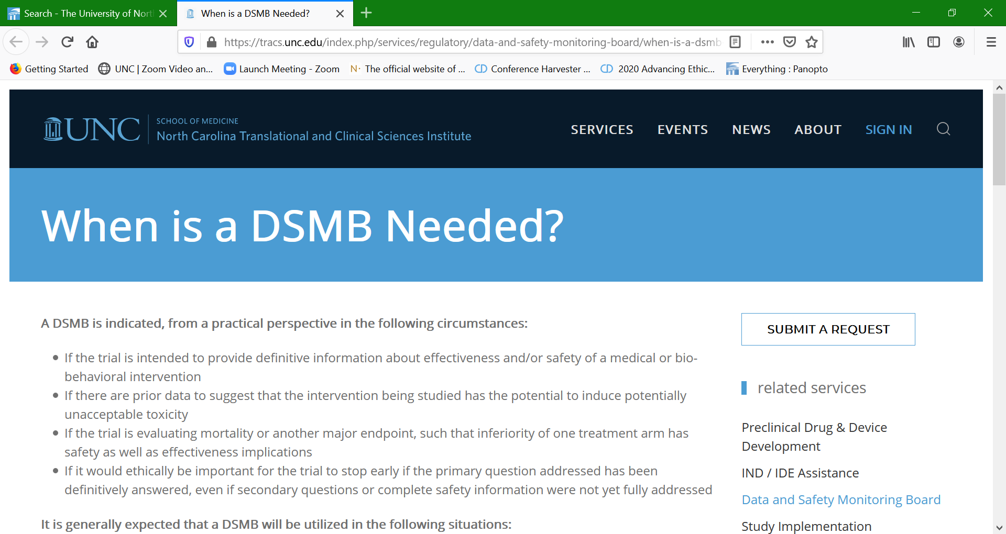
TraCs Resources https://tracs.unc.edu/index.php/services/regulatory/data-and-safety-monitoring-board/when-is-a-dsmb-needed Services available, at no cost, to any UNC faculty or staff. Please feel free to make referrals

Slide 10
DSMB Resources
Policies and Guidelines
NIH Policy for Data and Safety Monitoring
Further Guidance on a Data and Safety Monitoring for Phase I and Phase II Trials
NCI Data and Safety Monitoring Guidelines
NIA guidance on Data and Safety Monitoring
NIDDK guidance on Data and Safety Monitoring Plans
NC TraCS DSMB Forms
DSMB Report Form Template
Protection and Monitoring Plan Requirements
To request a Letter of Support or a copy of the NC TraCS DSMB Charter, please contact the DSMB Administrator, Amanda Wood.
Resources
DSMB Training Manual
Suggested Reading
Susan S. Ellenberg, Thomas R. Fleming, and David L. DeMets. Data Monitoring in Clinical Trials: A Practical Perspective. John Wiley & Sons, Ltd, 2003.
Submit a request
https://tracs.unc.edu/index.php/services/regulatory/data-and-safety-monitoring-board/dsmb-resources

Slide 11
The Buck Stops with the IRB!
The IRB’s mandate is the protection of the research subject,
Minimizing research risks
Ensuring the subject or their LAR are fully informed & consent to join the study.
ONLY then can the IRB approve a study to include human subjects in a study.

