Slide 1

111 Criteria for Approval # 8
Safeguards Vulnerable Populations

Slide 2
45 CFR 46.111( 8)
b) When some or all of the subjects are likely to be vulnerable to
coercion or undue influence,
such as children,
prisoners,
individuals with impaired decision-making capacity, or
economically or educationally disadvantaged persons, (situational too)
additional safeguards have been included in the study to protect the rights and welfare of these subjects.

Slide 3
Belmont Report & 45 CFR 46.111 & 21 CFR 56.111
Risks minimized Belmont: Respect for Persons & Beneficence
Favorable risk : benefit ratio Belmont: Respect for Persons & Beneficence
Equitable selection of subjects Belmont: Justice
Informed consent sought Belmont: Respect for Persons
Informed consent documented Belmont: Respect for Persons
Monitoring plan for safety Belmont: Beneficence
Privacy & confidentiality protected Belmont: Respect for Persons
Additional safeguards for vulnerable populations Belmont: Respect for Persons,
                Beneficence & Justice

Slide 4
“Ethics & Regulation of Clinical Research”
Robert J. Levine
Second Edition, 1986

Slide 5
Belmont says...
“Thus, there should first be a determination of the validity of the presuppositions of the research; then the nature, probability and magnitude of risk should be distinguished, with as much clarity as possible. The method of ascertaining risks should be explicit… It should be determined whether an investigator’s estimates of the probability of harm or benefits are reasonable, as judged by known facts or other available studies.”

Slide 6
Belmont Commission
Focus on a type of Comparative Justice--
Distributive Justice.

Slide 7
Distributive Justice
1. Distribution of scarce benefits, when there is competition for these benefits.
OR
2. If no scarcity, then distribution of burdens when “impose burdens on fewer than all members of a seemingly similar class of persons.”

Slide 8
Belmont’s Justice
1. Blend of Judeo-Christian tradition of protection of widows and orphans
2. Marxist dictum “from each according to ability; to each according to need”
3. Seen in subject selection.

Slide 9
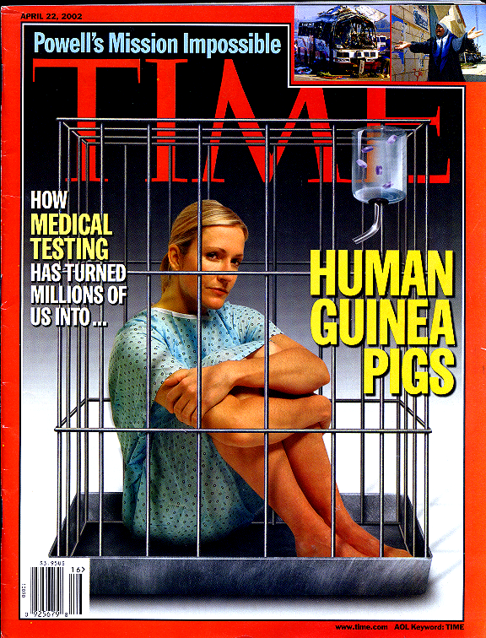
Consequences
Unknown health needs,
Unable to improve health of some populations
Guinea Pig Complex,
distrust of science
Distrust of medicine
  Avoiding care
  Health Issues become more severe
  Avoid immunizations

Slide 10

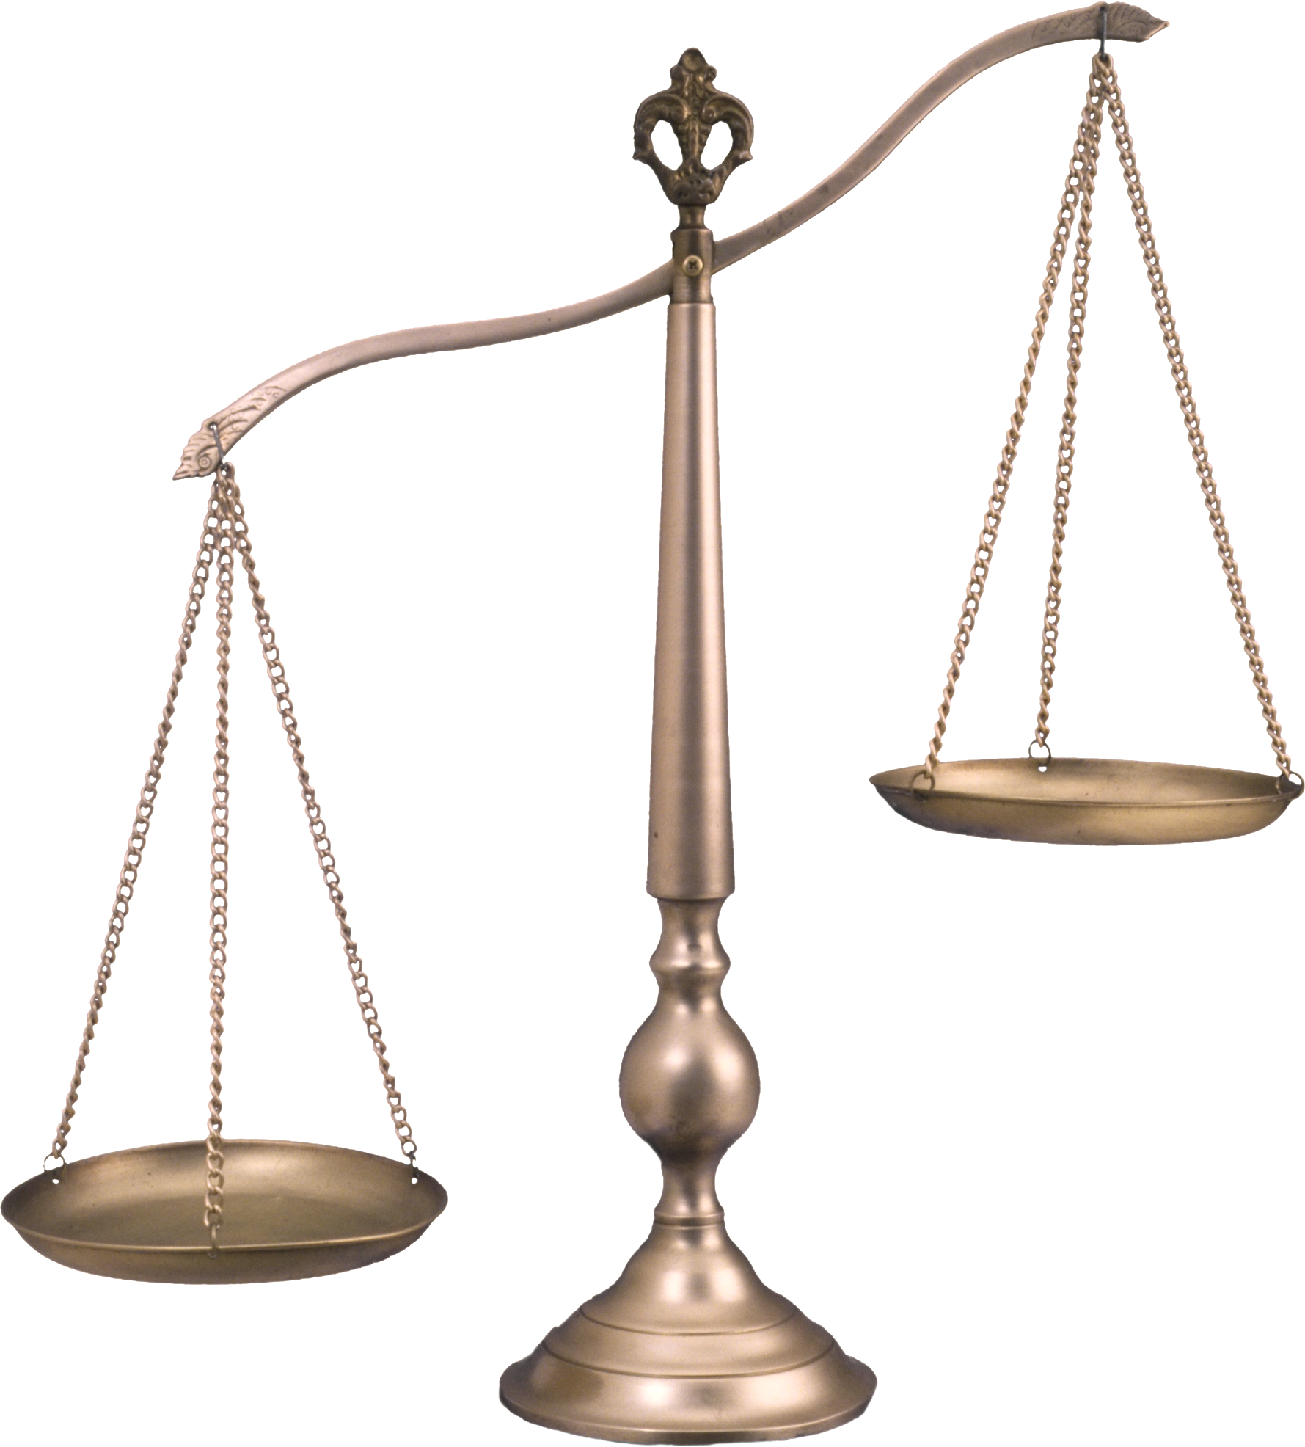
Why is this included as a criteria?
What are the consequences of not including vulnerable populations?
  Good: protected
  Bad: excluded from benefits of research
  Where are the scales
                In either situation?

Slide 11
Protections for Vulnerable Populations
IRB Assessment of Child Risk Levels
Protections for pregnant women & their fetus
Protections for prisoners from self –incrimination (COI) & discrimination from other prisoners
Those vulnerable to coercion

Slide 12
Vulnerable Subjects & 111 Criteria
Valid Study Design: to include or not include, what are the risks?
Subject Recruitment: easy or robust & diverse?
Informed Consent: really informed?
Safety Plan: does it match the risk level of the study?
Validity of Results: will results be appropriate for all populations?
Harms: Does this proposal results in harms to any cohort?

Slide 13


