Slide 1
Pregnant Research Subjects &
New FDA Guidance on X-Rays
July 2021 UNC IRB Education Presentation
Charlotte Coley
UNC Office of Human Research Ethics

Slide 2
Subpart B—Add’l Protections for Pregnant Women, Fetuses & Neonates in Research 46.202 Definitions.
(f) Pregnancy encompasses the period of time from implantation until delivery. A woman shall be assumed to be pregnant if she exhibits any of the pertinent presumptive signs of pregnancy, such as missed menses, until the results of a pregnancy test are negative or until delivery.

Slide 3
§46.203 Duties of IRBs in connection with research involving pregnant women, fetuses, and neonates.
In addition to other responsibilities assigned to IRBs under this part, each IRB shall review research covered by this subpart and approve only research which satisfies the conditions of all applicable sections of this subpart and the other subparts of this part.
Where scientifically appropriate, preclinical studies, including studies on pregnant animals, and clinical studies, including studies on nonpregnant women, have been conducted and provide data for assessing potential risks to pregnant women and fetuses;

Slide 4
Pregnant women or fetuses may be involved in research if all of the following conditions are met:
Balance of Risk & Benefits for Mother & Fetus
Who Consents? Just Mom or Mom & Dad ?

Slide 5
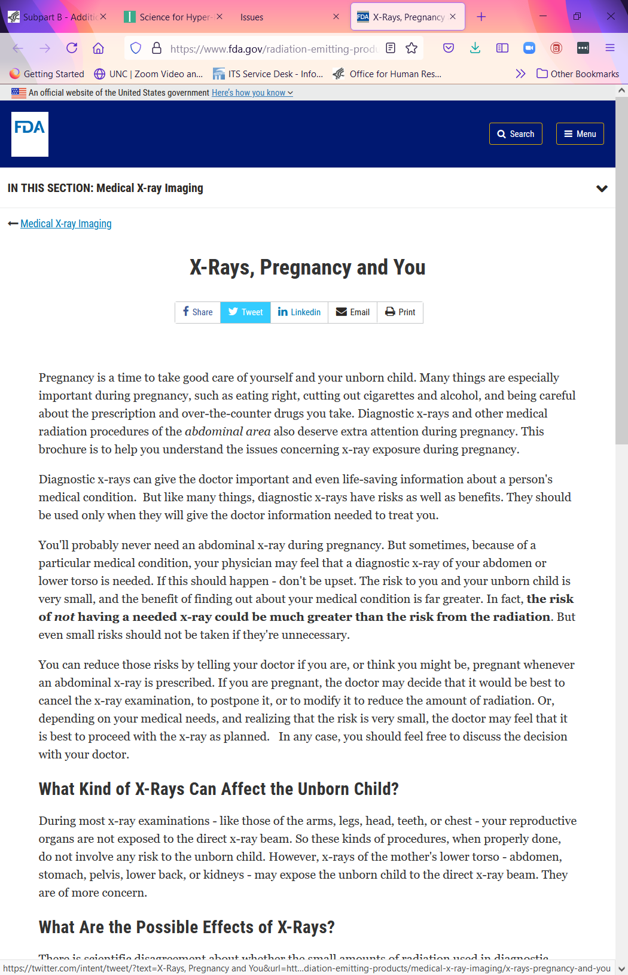
UNC Policy Update Based on New FDA Guidance https://www.fda.gov/radiation-emitting-products/medical-x-ray-imaging/x-rays-pregnancy-and-you

Slide 6
Risk of Radiation Exposure for Pregnant Women
What Kind of X-Rays Can Affect the Unborn Child?
During most x-ray examinations - like those of the arms, legs, head, teeth, or chest - your reproductive organs are not exposed to the direct x-ray beam. So these kinds of procedures, when properly done, do not involve any risk to the unborn child.
However, x-rays of the mother's lower torso - abdomen, stomach, pelvis, lower back, or kidneys - may expose the unborn child to the direct x-ray beam. They are of more concern.

Slide 7
Level of Risk
Targeted x-rays with proper shielding pose no risk to the fetus.
If the Board agrees the risk to the fetus is considered not greater than minimal risk then it is appropriate to include pregnant women. The use of the NSR device could be considered greater than minimal risk to the subjects (pregnant women), but pose no greater than minimal risk to the fetus in this case.

Slide 8
If a greater than minimal risk study is not excluding pregnant women should a pregnancy finding be made?
Yes
Slide courtesy of Brittane Foy

Slide 9
What if a greater than minimal risk study is excluding pregnant women unless they become pregnant during the study?
It depends
If they are collecting data to answer a research question then pregnant women should be considered a vulnerable population enrolled in the study.
If they are following subjects for just safety purposes then pregnant women would not be considered a vulnerable population enrolled in the study.
Slide courtesy of Brittane Foy

Slide 10
