Slide 1
Exempt Research
Notes:
DHHS – Department of Health and Human Services
OHRP – Office for Human Research Protections

Slide 2
Today’s agenda
Overview of Exempts
Focus on Category 2
Category 3
Limited IRB review
Break
Questions/discussion
Examples

Slide 3
What is Exempt Human Subjects Research?
Types of research that poses little, if any, risk to subjects, such as social, behavioral and educational research (SBER), as well as studies involving biospecimens.
Informational Risks Definition: The risk of harm to subjects from the loss of confidentiality of their personal information.
Exemption from the requirements of 45 CFR 46, if meets certain criteria.
Regulations allow IRBs to develop their own policies regarding whether, and how they apply the exemptions (IRBs should have clear policies and procedures).
Collaborative research, one Institution’s IRB may exempt a study while another Institution’s IRB may not.
FDA-regulated research cannot be granted an exemption

Slide 4
Who Makes Exempt Research Determinations?
The Common Rule does not specify who can make exempt research determinations and IRBs vary considerably in their exemption policies and practices.
DHHS and OHRP recommends that:
Because of the potential for conflict of interest, investigators may not be given the authority to make an independent determination that HSR is exempt.
IRBs specifies in their policies who within their Institution can make the determination.
At UNC this determination is typically made by an analyst, with or without a CIP, without the input of the chair
Notes:
DHHS – Department of Health and Human Services
OHRP – Office for Human Research Protections

Slide 5
What Information do IRBs Need to Make Exempt Research Determinations?
Given the complexity of the exemption options and criteria, IRBs should ensure their policies, processes, and forms elicits sufficient details about the study to make an accurate determination.
All research activities must fit into the exempt categories.
IRBs must assess data collection instruments (e.g., surveys, etc.) to assess risks (e.g., informational risks, risk of psychological harm).
IRBs should have enough information to identify which other laws, regulations and policies apply to the research (e.g., other countries, federal, state, tribal, local) that could affect the eligibility for exemption.

Slide 6
Categories of Exempt Review 45 CFR 46.104(d)
Normal educational practices in established educational settings
Educational tests, surveys, interviews, or observation of public behavior - unless identified & sensitive
Benign Behavioral Interventions
Research using secondary data and/or biospecimens (includes medical records)*
Evaluation of public benefit service programs
Taste and food quality evaluation and consumer acceptance studies
Storage or maintenance for secondary research for which Broad Consent is required
Secondary research for which Broad consent is required
*UNC doesn’t use category 4iii
Notes:
Category 1: Research conducted in established or commonly accepted educational settings, involving normal educational practices (refers to instructional techniques already in use or classroom management), such as
Research on regular and special education instructional strategies or
Research on the effectiveness of or the comparison among instructional techniques, curricula, or classroom management methods
Category 2: Research involving the use of educational tests (cognitive, diagnostic, aptitude, achievement) ,survey procedures, interview procedures or observation of public behavior, unless identified and sensitive. (If collecting sensitive information that is identifiable, then needs expedited review).
Category 3: Research involving benign behavioral interventions in conjunction with the collection of information from an adult subject through verbal or written responses (including data entry) or audiovisual recording if the subject prospectively agrees to the intervention and information collection.
Category 4: Research involving the collection or study of existing data, documents, records, pathological specimens, or diagnostic specimens, if these sources are publicly available or if the information is recorded by the investigator in such a manner that subjects cannot be identified, directly or through identifiers linked to the subjects.
Category 5: Research and demonstration projects that are conducted or supported by a Federal department or agency, and that are designed to study, evaluate, improve, or otherwise examine public benefit or service programs, including procedures for obtaining benefits or services under those programs, possible changes in or alternatives to those programs or procedures, or possible changes in methods or levels of payment for benefits or services under those programs
Category 6: Taste and food quality evaluation and consumer acceptance studies.
Category 7 and 8: Not used at UNC-CH.

Slide 7
Categories of Exempt Review 45 CFR 46.104(d)
Normal educational practices in established educational settings
Educational tests, surveys, interviews, or observation of public behavior - unless identified & sensitive
Benign Behavioral Interventions
Research using secondary data and/or biospecimens (includes medical records)
Evaluation of public benefit service programs
Taste and food quality evaluation and consumer acceptance studies
Storage or maintenance for secondary research for which Broad Consent is required
Secondary research for which Broad consent is required
*UNC doesn’t use category 4iii (More about this next week)
Notes:
Category 1: Research conducted in established or commonly accepted educational settings, involving normal educational practices (refers to instructional techniques already in use or classroom management), such as
Research on regular and special education instructional strategies or
Research on the effectiveness of or the comparison among instructional techniques, curricula, or classroom management methods
Category 2: Research involving the use of educational tests (cognitive, diagnostic, aptitude, achievement) ,survey procedures, interview procedures or observation of public behavior, unless identified and sensitive. (If collecting sensitive information that is identifiable, then needs expedited review).
Category 3: Research involving benign behavioral interventions in conjunction with the collection of information from an adult subject through verbal or written responses (including data entry) or audiovisual recording if the subject prospectively agrees to the intervention and information collection.
Category 4: Research involving the collection or study of existing data, documents, records, pathological specimens, or diagnostic specimens, if these sources are publicly available or if the information is recorded by the investigator in such a manner that subjects cannot be identified, directly or through identifiers linked to the subjects.
Category 5: Research and demonstration projects that are conducted or supported by a Federal department or agency, and that are designed to study, evaluate, improve, or otherwise examine public benefit or service programs, including procedures for obtaining benefits or services under those programs, possible changes in or alternatives to those programs or procedures, or possible changes in methods or levels of payment for benefits or services under those programs
Category 6: Taste and food quality evaluation and consumer acceptance studies.
Category 7 and 8: Not used at UNC-CH.

Slide 8
Exemption 2: Educational Tests, Surveys, Interviews, or Observations
Research that only includes interactions involving educational tests (cognitive, diagnostic, aptitude, achievement), survey procedures, interview procedures, or observation of public behavior (including visual or auditory recording) if at least one of the following criteria is met:
(i) The information obtained is recorded by the investigator in such a manner that the identity of the human subjects cannot readily be ascertained, directly or through identifiers linked to the subjects;
(ii) Any disclosure of the human subjects' responses outside the research would not reasonably place the subjects at risk of criminal or civil liability or be damaging to the subjects' financial standing, employability, educational advancement, or reputation; or
(iii) The information obtained is recorded by the investigator in such a manner that the identity of the human subjects can readily be ascertained, directly or through identifiers linked to the subjects, and an IRB conducts a limited IRB review to make the determination required by 46.111(a)(7).
Notes:
Research that ONLY includes. If other data collection methods are used, can’t qualify for exemption.
Focus groups are included in “interview procedures”
If at least one of the criteria is met
It is ok to only check one. They don’t have to check i or iii even if you really want them to
(i) Anonymous data
(ii) Really low risk data
(iii) Identifiers stored, limited IRB review for confidentiality
Publicly available: any place with no special requirements to access, no reasonable expectation of privacy

Slide 9
Exemption 2: Educational Tests, Surveys, Interviews, or Observations
If other data collection methods are used in addition to these, the study may not qualify for exemption
Research that only includes interactions involving educational tests (cognitive, diagnostic, aptitude, achievement), survey procedures, interview procedures, or observation of public behavior (including visual or auditory recording) if at least one of the following criteria is met:
(i) The information obtained is recorded by the investigator in such a manner that the identity of the human subjects cannot readily be ascertained, directly or through identifiers linked to the subjects;
(ii) Any disclosure of the human subjects' responses outside the research would not reasonably place the subjects at risk of criminal or civil liability or be damaging to the subjects' financial standing, employability, educational advancement, or reputation; or
(iii) The information obtained is recorded by the investigator in such a manner that the identity of the human subjects can readily be ascertained, directly or through identifiers linked to the subjects, and an IRB conducts a limited IRB review to make the determination required by 46.111(a)(7).
Includes focus groups
What’s considered public?
Anywhere that doesn’t require any special permissions to access
The subject doesn’t have a reasonable expectation of privacy
Notes:
Research that ONLY includes. If other data collection methods are used, can’t qualify for exemption.
Focus groups are included in “interview procedures”
If at least one of the criteria is met
It is ok to only check one. They don’t have to check i or iii even if you really want them to
(i) Anonymous data
(ii) Really low risk data
(iii) Identifiers stored, limited IRB review for confidentiality
Publicly available: any place with no special requirements to access, no reasonable expectation of privacy

Slide 10
Exemption 2: Educational Tests, Surveys, Interviews, or Observations
Research that only includes interactions involving educational tests (cognitive, diagnostic, aptitude, achievement), survey procedures, interview procedures, or observation of public behavior (including visual or auditory recording) if at least one of the following criteria is met:
(i) The information obtained is recorded by the investigator in such a manner that the identity of the human subjects cannot readily be ascertained, directly or through identifiers linked to the subjects;
(ii) Any disclosure of the human subjects' responses outside the research would not reasonably place the subjects at risk of criminal or civil liability or be damaging to the subjects' financial standing, employability, educational advancement, or reputation; or
(iii) The information obtained is recorded by the investigator in such a manner that the identity of the human subjects can readily be ascertained, directly or through identifiers linked to the subjects, and an IRB conducts a limited IRB review to make the determination required by 46.111(a)(7).
ONLY ONE of these needs to be selected and justified in IRBIS for us to allow exemption.
We can assess these criteria independently It’s always the case that either (i) or (iii) is true, but we can exempt it without one of those being selected if (ii) is true
Notes:
Research that ONLY includes. If other data collection methods are used, can’t qualify for exemption.
Focus groups are included in “interview procedures”
If at least one of the criteria is met
It is ok to only check one. They don’t have to check i or iii even if you really want them to
(i) Anonymous data
(ii) Really low risk data
(iii) Identifiers stored, limited IRB review for confidentiality
Publicly available: any place with no special requirements to access, no reasonable expectation of privacy

Slide 11
Exemption 2: Educational Tests, Surveys, Interviews, or Observations
Research that only includes interactions involving educational tests (cognitive, diagnostic, aptitude, achievement), survey procedures, interview procedures, or observation of public behavior (including visual or auditory recording) if at least one of the following criteria is met:
(i) The information obtained is recorded by the investigator in such a manner that the identity of the human subjects cannot readily be ascertained, directly or through identifiers linked to the subjects;
(ii) Any disclosure of the human subjects' responses outside the research would not reasonably place the subjects at risk of criminal or civil liability or be damaging to the subjects' financial standing, employability, educational advancement, or reputation; or
(iii) The information obtained is recorded by the investigator in such a manner that the identity of the human subjects can readily be ascertained, directly or through identifiers linked to the subjects, and an IRB conducts a limited IRB review to make the determination required by 46.111(a)(7).
Participation should be anonymous. If identifiers are collected or otherwise known (e.g. sent to an existing list of email addresses), they shouldn’t be able to be associated with responses.
Check this response against A.9 and A.10 in the application.
If a linkage file is kept, this doesn’t apply. If the responses will be received with identifiers which will later be removed, this doesn’t apply.
In this case, it doesn’t matter what the topic area is, because participants can’t be identified.
Notes:
Research that ONLY includes. If other data collection methods are used, can’t qualify for exemption.
Focus groups are included in “interview procedures”
If at least one of the criteria is met
It is ok to only check one. They don’t have to check i or iii even if you really want them to
(i) Anonymous data
(ii) Really low risk data
(iii) Identifiers stored, limited IRB review for confidentiality
Publicly available: any place with no special requirements to access, no reasonable expectation of privacy

Slide 12
Exemption 2: Educational Tests, Surveys, Interviews, or Observations
If responses were accidentally disclosed, there is no risk to participants, because the subject matter is so benign that it’s unlikely to cause them any harm.
Check this against A.6 of the application. Topics that likely do not meet this criteria: mental health, financial struggles, substance use (legal or not), controversial political issues, anything sensitive or embarrassing.
In this case, it doesn’t matter whether or not identifiers are collected, because the responses are benign.
Research that only includes interactions involving educational tests (cognitive, diagnostic, aptitude, achievement), survey procedures, interview procedures, or observation of public behavior (including visual or auditory recording) if at least one of the following criteria is met:
(i) The information obtained is recorded by the investigator in such a manner that the identity of the human subjects cannot readily be ascertained, directly or through identifiers linked to the subjects;
(ii) Any disclosure of the human subjects' responses outside the research would not reasonably place the subjects at risk of criminal or civil liability or be damaging to the subjects' financial standing, employability, educational advancement, or reputation; or
(iii) The information obtained is recorded by the investigator in such a manner that the identity of the human subjects can readily be ascertained, directly or through identifiers linked to the subjects, and an IRB conducts a limited IRB review to make the determination required by 46.111(a)(7).
Notes:
Research that ONLY includes. If other data collection methods are used, can’t qualify for exemption.
Focus groups are included in “interview procedures”
If at least one of the criteria is met
It is ok to only check one. They don’t have to check i or iii even if you really want them to
(i) Anonymous data
(ii) Really low risk data
(iii) Identifiers stored, limited IRB review for confidentiality
Publicly available: any place with no special requirements to access, no reasonable expectation of privacy

Slide 13
Exemption 2: Educational Tests, Surveys, Interviews, or Observations
Identifiers can be collected and associated with responses. Check this against A.9 and A.10 in the application.
The subject matter doesn’t have to be so benign that (ii) is checked. However if it’s very sensitive (e.g. illegal behavior, sexual behavior) expedited may be more appropriate.
Research that only includes interactions involving educational tests (cognitive, diagnostic, aptitude, achievement), survey procedures, interview procedures, or observation of public behavior (including visual or auditory recording) if at least one of the following criteria is met:
(i) The information obtained is recorded by the investigator in such a manner that the identity of the human subjects cannot readily be ascertained, directly or through identifiers linked to the subjects;
(ii) Any disclosure of the human subjects' responses outside the research would not reasonably place the subjects at risk of criminal or civil liability or be damaging to the subjects' financial standing, employability, educational advancement, or reputation; or
(iii) The information obtained is recorded by the investigator in such a manner that the identity of the human subjects can readily be ascertained, directly or through identifiers linked to the subjects, and an IRB conducts a limited IRB review to make the determination required by 46.111(a)(7).
If (iii) is the ONLY subcategory selected and justified in the application, the study will receive Limited IRB Review.
From the 111 criteria: “there are adequate provisions to protect the privacy of subjects and to maintain the confidentiality of data.”
Notes:
Research that ONLY includes. If other data collection methods are used, can’t qualify for exemption.
Focus groups are included in “interview procedures”
If at least one of the criteria is met
It is ok to only check one. They don’t have to check i or iii even if you really want them to
(i) Anonymous data
(ii) Really low risk data
(iii) Identifiers stored, limited IRB review for confidentiality
Publicly available: any place with no special requirements to access, no reasonable expectation of privacy

Slide 14
Exemption & Vulnerable Populations
Exemption Category | Subpart D (Children) | Subpart B (Pregnant Women, Fetuses, IVF) | Subpart C (Prisoners)
1 – Normal Education Practices | May be applied | Each of the exemptions may be applies | None of the exemptions may be applied except for research aimed at involving a broader population that only incidentally includes prisoners
2 (i) – Educational tests, surveys, interviews or observations: Anonymous | May only be applied to educational tests and observation of public behavior when the investigator(s) do not participate in the activities being observed
2 (ii) – Educational tests, surveys, interviews or observations: Not sensitive
2 (iii) – Educational tests, surveys, interviews or observations: Not anonymous, but has Limited IRB Review | May NOT be applied
3 – Benign Behavioral Intervention | May NOT be applied
4 – Secondary research for which consent is not required | May be applied
5 – Public benefit or service programs | May be applied
6 – Taste and food quality evaluation and consumer | May be applied

Slide 15
Exemption 3: Benign Behavioral Interventions Including Adults
(i) Research involving benign behavioral interventions in conjunction with the collection of information from an adult subject through verbal or written responses (including data entry) or audiovisual recording if the subject prospectively agrees to the intervention and information collection and at least one of the following criteria is met:
(A) The information obtained is recorded by the investigator in such a manner that the identity of the human subjects cannot readily be ascertained, directly or through identifiers linked to the subjects;
(B) Any disclosure of the human subjects' responses outside the research would not reasonably place the subjects at risk of criminal or civil liability or be damaging to the subjects' financial standing, employability, educational advancement, or reputation; or
(C) The information obtained is recorded by the investigator in such a manner that the identity of the human subjects can readily be ascertained, directly or through identifiers linked to the subjects, and an IRB conducts a limited IRB review to make the determination required by 46.111(a)(7).
(ii) For the purpose of this provision, benign behavioral interventions are brief in duration, harmless, painless, not physically invasive, not likely to have a significant adverse lasting impact on the subjects, and the investigator has no reason to think the subjects will find the interventions offensive or embarrassing. Provided all such criteria are met, examples of such benign behavioral interventions would include having the subjects play an online game, having them solve puzzles under various noise conditions, or having them decide how to allocate a nominal amount of received cash between themselves and someone else.

Slide 16
Exemption 3: Benign Behavioral Interventions Including Adults
Only adults
(i) Research involving benign behavioral interventions in conjunction with the collection of information from an adult subject through verbal or written responses (including data entry) or audiovisual recording if the subject prospectively agrees to the intervention and information collection and at least one of the following criteria is met:
(A) The information obtained is recorded by the investigator in such a manner that the identity of the human subjects cannot readily be ascertained, directly or through identifiers linked to the subjects;
(B) Any disclosure of the human subjects' responses outside the research would not reasonably place the subjects at risk of criminal or civil liability or be damaging to the subjects' financial standing, employability, educational advancement, or reputation; or
(C) The information obtained is recorded by the investigator in such a manner that the identity of the human subjects can readily be ascertained, directly or through identifiers linked to the subjects, and an IRB conducts a limited IRB review to make the determination required by 46.111(a)(7).
(ii) For the purpose of this provision, benign behavioral interventions are brief in duration, harmless, painless, not physically invasive, not likely to have a significant adverse lasting impact on the subjects, and the investigator has no reason to think the subjects will find the interventions offensive or embarrassing. Provided all such criteria are met, examples of such benign behavioral interventions would include having the subjects play an online game, having them solve puzzles under various noise conditions, or having them decide how to allocate a nominal amount of received cash between themselves and someone else.
Notes:
SACHRP: do not include physical (bodily) tasks or physical manipulations (e.g., range of motion activities, physical exercise) unless these are minor activities that are incident to the behavioral intervention and do not increase risk.
SACHRP guidance: Brief in duration is intended to refer to the intervention as opposed to the intervention and the data collection activities together. Thus, the data collection activities could proceed over a longer period of time without precluding the applicability of this exemption. If the intervention and the data collection are intertwined or difficult to separate, the entirety of the activity should be brief in duration. To meet the requirement of brief in duration, the benign behavioral intervention should last a few minutes to a few hours. While it does not have to occur in a single session, the entire time for the intervention should occur on a single day and not exceed a few hours in its entirety.

Slide 17
Exemption 3: Benign Behavioral Interventions Including Adults
(i) Research involving benign behavioral interventions in conjunction with the collection of information from an adult subject through verbal or written responses (including data entry) or audiovisual recording if the subject prospectively agrees to the intervention and information collection and at least one of the following criteria is met:
(A) The information obtained is recorded by the investigator in such a manner that the identity of the human subjects cannot readily be ascertained, directly or through identifiers linked to the subjects;
(B) Any disclosure of the human subjects' responses outside the research would not reasonably place the subjects at risk of criminal or civil liability or be damaging to the subjects' financial standing, employability, educational advancement, or reputation; or
(C) The information obtained is recorded by the investigator in such a manner that the identity of the human subjects can readily be ascertained, directly or through identifiers linked to the subjects, and an IRB conducts a limited IRB review to make the determination required by 46.111(a)(7).
(ii) For the purpose of this provision, benign behavioral interventions are brief in duration, harmless, painless, not physically invasive, not likely to have a significant adverse lasting impact on the subjects, and the investigator has no reason to think the subjects will find the interventions offensive or embarrassing. Provided all such criteria are met, examples of such benign behavioral interventions would include having the subjects play an online game, having them solve puzzles under various noise conditions, or having them decide how to allocate a nominal amount of received cash between themselves and someone else.
Same deal as exempt 2

Slide 18
Exemption 3: Benign Behavioral Interventions Including Adults
(i) Research involving benign behavioral interventions in conjunction with the collection of information from an adult subject through verbal or written responses (including data entry) or audiovisual recording if the subject prospectively agrees to the intervention and information collection and at least one of the following criteria is met:
(A) The information obtained is recorded by the investigator in such a manner that the identity of the human subjects cannot readily be ascertained, directly or through identifiers linked to the subjects;
(B) Any disclosure of the human subjects' responses outside the research would not reasonably place the subjects at risk of criminal or civil liability or be damaging to the subjects' financial standing, employability, educational advancement, or reputation; or
(C) The information obtained is recorded by the investigator in such a manner that the identity of the human subjects can readily be ascertained, directly or through identifiers linked to the subjects, and an IRB conducts a limited IRB review to make the determination required by 46.111(a)(7).
(ii) For the purpose of this provision, benign behavioral interventions are brief in duration, harmless, painless, not physically invasive, not likely to have a significant adverse lasting impact on the subjects, and the investigator has no reason to think the subjects will find the interventions offensive or embarrassing. Provided all such criteria are met, examples of such benign behavioral interventions would include having the subjects play an online game, having them solve puzzles under various noise conditions, or having them decide how to allocate a nominal amount of received cash between themselves and someone else.

Slide 19
Exemption 3 & Withholding/Deception
(iii) If the research involves deceiving the subjects regarding the nature or purposes of the research, this exemption is not applicable unless the subject authorizes the deception through a prospective agreement to participate in research in circumstances in which the subject is informed that he or she will be unaware of or misled regarding the nature or purposes of the research.
Notes:
SACHRP: permits research involving deception only when the subject agrees to participate in research following disclosure of the fact that he or she will be unaware of or misled regarding the nature or purpose of the research. Researchers should consider debriefing after the intervention, as appropriate

Slide 20
Exemption 3 & Withholding/Deception
(iii) If the research involves deceiving the subjects regarding the nature or purposes of the research, this exemption is not applicable unless the subject authorizes the deception through a prospective agreement to participate in research in circumstances in which the subject is informed that he or she will be unaware of or misled regarding the nature or purposes of the research.
This can be as simple as one sentence in the consent form. If investigators don’t want to do this, expedited 7 with “A waiver or alteration of elements” is an option.
Note: Subjects should be debriefed and given the full/correct information. This is not a regulatory requirement, but our policy is to ask for this.
“if the subject prospectively agrees to the intervention and information collected”

Slide 21
Exemption & Limited IRB Review
The Common Rule requires limited IRB review for several select exemption categories
The IRB determines that appropriate confidentiality protections are in place (per 46.111(a)(7)).
At UNC this applies to Exempt 2(iii) and 3(C), where identifiers are collected
When these items are selected in IRBIS, additional sections of the application open up to allow us to make the determination (B.1, B.3, and A.10)

Slide 22
Exemption & Limited IRB Review
IRB Chair or an experienced IRB member performs the Limited IRB Review. Currently UNC operationalizes this as only chairs or staff with a CIP.
There is no continuing review required for studies approved via Limited IRB review.

Slide 24
References:
Institutional Review Board: Management and Function
Code of Federal Regulations: 45 CFR 46 – Protection of Human Subjects

Slide 25
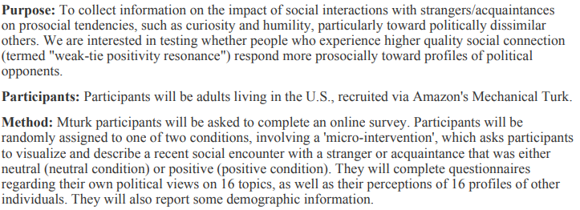
Example #1

Slide 26
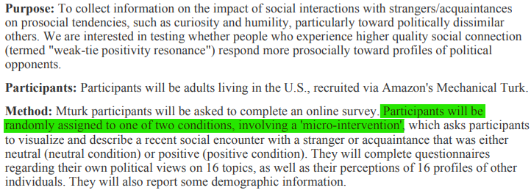
Example #1
Category 3, benign behavioral intervention
Participants are being randomized to different conditions
Also category 2, as participants will complete surveys

Slide 27
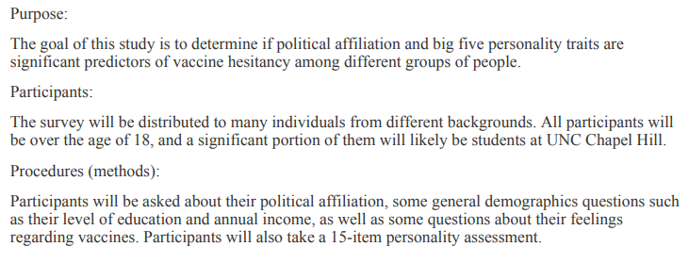
Example #2

Slide 28
Example #2
Exempt 2 The study is collecting information through written responses, but there is no behavioral intervention.

Slide 29
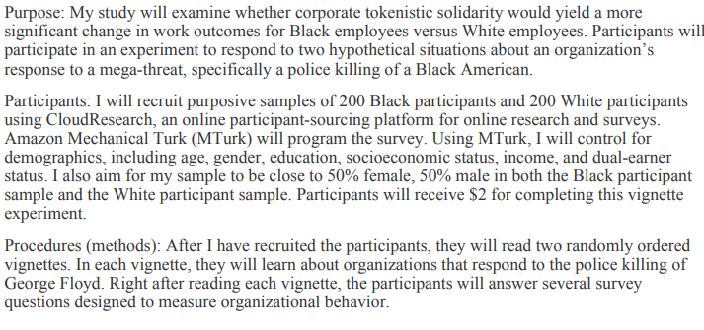
Example #3

Slide 30
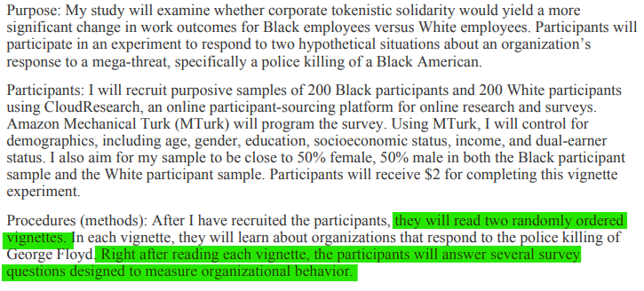
Example #3
Category 3, benign behavioral intervention
Participants are being exposed to the same vignettes, but in a random order to see how their responses to the survey will be affected.

Slide 31
Example #4

Slide 32
Example #4
Probably Exempt 3 Does anything stand out about this?

Slide 33
Example #4
They will be told “You scored lower than 80% of your classmates no matter how well they did. Study involves deception. Only allowable if participants are prospectively informed.

Slide 34
Withholding/Deception
Nope. Not negotiable for an exemption.

Slide 35
Withholding/Deception
What I ask for in this case is:
Describe how participants will prospectively agree to information being withheld or being deceived
In the consent form this should include a statement about withholding/deception
Participants should be debriefed and given the full/correct information
This should be present in the attachments and in the “Consent Process for Exemptions” section of the application
If participants will be debriefed this should also be included in “Consent Process for Exemptions”
In the study design (A.4.2) Include the withholding/deception as part of the study design

Slide 37
What exempt category is this?
An investigator will use a de-identified consumer database to compare spending habits of adults in the 1990s to the spending habits of adults today to determine which industries millennials are killing.
Exempt 4

Slide 38
What exempt category is this?
An investigator is developing a new ad campaign to promote COVID vaccines in the Southern US. They will want to survey adults and get feedback on both the new and the old ads.
Exempt 3

Slide 39
What exempt category is this?
An investigator has developed a new supplemental curriculum to teach vocabulary to high school students. They will compare assessments from one school who adopted the curriculum to another that did not.
Exempt 1

Slide 40
What exempt category is this?
An investigator wants to survey parents of elementary school kids about their thoughts on child screen time and how much screen time they allow their children.
Exempt 2

Slide 41
What exempt category is this?
An investigator is developing a new ad campaign to promote PReP for HIV prevention in the Southern US. They will want to survey adults and get feedback on both the new and the old ads.
BUT, to avoid bias regarding HIV, they will change the content of the ads to be about Fish Oil for heart disease prevention
Exempt 3
(Including withholding of information)

Slide 42
Practical reminders
Currently, IRBIS doesn’t allow for an exemption to be granted if the application is a full form. If they submit as full form and you think it qualifies for an exemption, ask them to change the application type. Don’t over-apply the regulations!
The “consent form” section of IRBIS doesn’t typically open up for exempt studies. Your consent forms/information sheets will typically be in the “Attachments” section and will often be embedded within the survey itself.

Slide 43
References:
Institutional Review Board: Management and Function
Code of Federal Regulations: 45 CFR 46 – Protection of Human Subjects

