Slide 1
Expedited Categories 2 and 3

Slide 2
Expedited Review Categories (DHHS 1998)
Studies of drugs and medical devices when no IND or IDE is needed.
Blood samples by finger stick, heel stick, ear stick, or venipuncture.
Biological specimens for research purposes by “noninvasive” means.
Data through noninvasive procedures (not involving general anesthesia or sedation) routinely employed in clinical practice, excluding procedures involving x-rays or microwaves.
Materials (data, documents, records, or specimens) that have been collected, or will be collected solely for nonresearch purposes. Evaluation of public benefit service programs
Data from voice, video, digital, or image recordings made for research purposes.
Research employing survey, interview, oral history, focus group, etc.
Continuing review of research previously approved by the convened IRB where:
(a) only-follow-up remains,
(b) no subjects enrolled, and no additional risks identified, or
(c) only data analysis remains.
Continuing review where:
(1) not conducted under an IND/IDE,
(2) other expedited categories are not applicable, and
(3) Board considers minimal risk.
Notes:
Category 1 - NOT being conducted under an Investigational New Drug (IND) application or Investigational Device Exemption (IDE) application. These are normally studies using approved drugs, being used accordingly to the label. Devices that are cleared/approved and use accordingly to label.
Category 2 – There some limits for the amount and the frequency of the blood draws – we need to consider the population being studied, consider age, weight, health of the subjects.
Category 3 – Prospective collection of specimens – saliva, stool samples, hair and nail clippings, deciduous teeth at time of exfoliation or if patient care indicates the need to extract (this is valid for permanent teeth), placenta removed at delivery, etc.
Category 4 - Collection of data through noninvasive procedures (not involving general anesthesia or sedation) routinely employed in clinical practice, excluding procedures involving x-rays or microwaves. Where medical devices are employed, they must be cleared/approved for marketing.
Category 5 - Research involving materials (data, documents, records, or specimens) that have been collected, or will be collected solely for nonresearch purposes (such as medical treatment or diagnosis).
Category 6 - Collection of data from voice, video, digital, or image recordings made for research purposes.
Category 7 - Research on individual or group characteristics or behavior (including, but not limited to, research on perception, cognition, motivation, identity, language, communication, cultural beliefs or practices, and social behavior) or research employing survey, interview, oral history, focus group, program evaluation, human factors evaluation, or quality assurance methodologies.
Category 8 – Continuing review of research previously approved by the convened IRB where: (a) only-follow-up remains, (b) no subjects enrolled, and no additional risks have been identified or (c) only data analysis remains.
Category 9 - Continuing review of research not conducted under an investigational new drug application or investigational device exemption where categories two (2) through eight (8) do not apply but the IRB has determined and documented at a convened meeting that the research involves no greater than minimal risk and no additional risks have been identified.
This category typically applies to protocols that are clearly minimal risk but did not fit an existing expedited category at the time of initial review.

Slide 3
A Few Items to Keep in Mind…
We will speak about the categories individually; however, they often occur together within the same study​.
In order to qualify for expedited review all research activities must:
Fall into the expedited categories​
Be no more than minimal risk​
The review level applies to the entire study. If certain activities could qualify for exemption, but other activities require expedited review, the whole study must be considered expedited.

Slide 4
Expedited Categories 2 and 3
These categories involve prospective collection of specimens by the researchers.
May apply to vulnerable populations.

Slide 5
Expedited Category 2
Collection of blood samples by finger stick, heel stick, ear stick, or venipuncture as follows:
from healthy, nonpregnant adults who weigh at least 110 pounds. For these subjects, the amounts drawn may not exceed 550 ml in an 8-week period and collection may not occur more frequently than 2 times per week; or
from other adults and children, considering the age, weight, and health of the subjects, the collection procedure, the amount of blood to be collected, and the frequency with which it will be collected. For these subjects, the amount drawn may not exceed the lesser of 50 ml or 3 ml per kg in an 8-week period and collection may not occur more frequently than 2 times per week.
Notes:
Healthy subjects: Cannot exceed 550 ml total in an 8-week period – Cannot draw more frequently than 2 times per week.
Unhealthy subjects Cannot exceed 50 ml total in an 8-week period - Cannot draw more frequently than 2 times per week.
Children subjects: Cannot exceed 3 ml per kg total in an 8-week period - Cannot draw more frequently than 2 times per week (Consider age and weight).

Slide 6
Healthy vs. Unhealthy Subjects
Chronic Conditions
Need to assess if the subject could be considered “healthy” at the moment.
Cancer
Diabetes
Crohn’s disease
HIV vs. AIDS
Notes:
How to determine if a subject is healthy? If unsure, please reach out to the Chair of the Day (COD).
Chronic conditions – need to assess if the subject could be considered “healthy” at the moment. (Diabetes, Crohn’s disease)
Cancer subjects – considered unhealthy
HIV Human Immunodeficiency Virus) – does not make the subjects unhealthy, however, if they have AIDS (Acquired Immune Deficiency Syndrome) they are considered unhealthy.
AIDS - Medical condition – immune system is too weak to fight infections.
HIV – Virus which attacks the immune system.

Slide 7
What Should We Consider When Determining if Fits Expedited Category 2?
Population
Collection procedure
Amount of blood to be collected
Frequency of blood draws
Notes:
- Population
Collection procedure – finger stick, heel stick, ear stick, venipuncture – Is this appropriate for this population?
Amount of blood to be collected
Frequency

Slide 8
Standard of Care vs. Research Collection
If blood collection for research purposes is being conducted in combination with a standard of care collection, the IRB does not need to know the total combined amount of blood.
IRB is responsible to oversee the research collection only.

Slide 9
Expedited Category 3
Prospective collection of biological specimens for research purposes by noninvasive means.
Examples:
(a) hair and nail clippings in a nondisfiguring manner;
(b) deciduous teeth at time of exfoliation or if routine patient care indicates a need for extraction;
(c) permanent teeth if routine patient care indicates a need for extraction;
(d) excreta and external secretions (including sweat);
(e) uncannulated saliva collected either in an unstimulated fashion or stimulated by chewing gumbase or wax or by applying a dilute citric solution to the tongue;
(f) placenta removed at delivery;
(g) amniotic fluid obtained at the time of rupture of the membrane prior to or during labor;
(h) supra- and subgingival dental plaque and calculus, provided the collection procedure is not more invasive than routine prophylactic scaling of the teeth and the process is accomplished in accordance with accepted prophylactic techniques;
(i) mucosal and skin cells collected by buccal scraping or swab, skin swab, or mouth washings;
(j) sputum collected after saline mist nebulization.

Slide 10
What is Noninvasive?
Per the FDA regulations, noninvasive, when applied to a diagnostic device or procedure, means one that does not by design or intention:
(1) Penetrate or pierce the skin or mucous membranes of the body, the ocular cavity, or the urethra, or
(2) enter the ear beyond the external auditory canal, the nose beyond the nares, the mouth beyond the pharynx, the anal canal beyond the rectum, or the vagina beyond the cervical os.
For purposes of this part, blood sampling that involves simple venipuncture is considered noninvasive, and the use of surplus samples of body fluids or tissues that are left over from samples taken for noninvestigational purposes is also considered noninvasive.

Slide 11
Noninvasive vs. Invasive Swabs
https://dtpm.com/articles/swab-collection-methods-for-covid-19-testing/
Notes:
Oropharyngeal swab – Invasive – Full Board
Oral swab – Noninvasive – Expedited Category 3

Slide 12
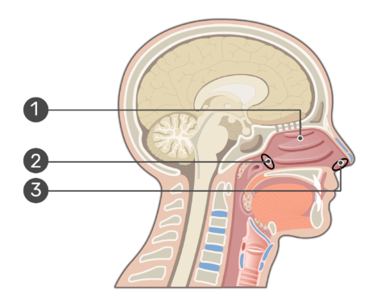
Noninvasive vs. Invasive Swabs
“Past the nares” can be define differently.
Anterior nares or external nares – Nasal cavity
Posterior nares or internal nares – Nasopharynx
1. Nasal cavity
2. Posterior nares
3. Anterior nares
https://www.getbodysmart.com/nasal-cavity/nose-anatomy-physiology/
Notes:
When talking about nasal/nasopharyngeal swabs – remember that “nares” can be defined differently….
Read slide – passing the nostrils we access the nasal cavity….
Nasal endoscopy - sinus - past the nares - FB
Nasal epithelial lining fluid collection (NELF) - have to go past the nares with the filter paper, that is technically invasive sampling.
Nasal epithelial lining fluid is considered an invasive sampling per federal regulations, as it goes beyond the nares.

Slide 13
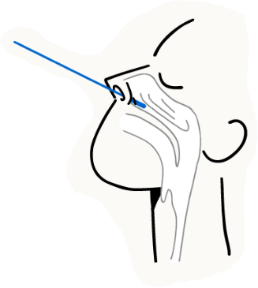
Nasopharyngeal Swab vs. Nasal Swab
Nasopharyngeal swab
Nasal or mid-turbinate swab
Invasive
Full Board Review
Noninvasive
Expedited Review
https://twitter.com/RocheDia/status/1377645110301577223/photo/1
Notes:
Nasal endoscopy - sinus - past the nares - FB
Nasal epithelial lining fluid collection (NELF) - have to go past the nares with the filter paper, that is technically invasive sampling.
Nasal epithelial lining fluid is considered an invasive sampling per federal regulations, as it goes beyond the nares.

Slide 14
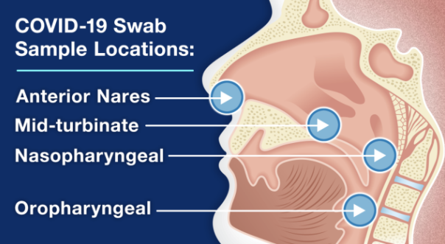
Noninvasive vs. Invasive Swabs
https://www.nbc26.com/news/local-news/should-you-swab-your-throat-when-testing-at-home-for-covid-19
Notes:
Here we can see how COVID samples are collected – nasopharyngeal swab and oropharyngeal swab.

Slide 15
Expedited Categories & Limited Waiver of HIPAA Authorization
Limited Waiver of HIPAA
Allows for access to existing medical records for the purpose of identifying and making initial contact with potential subjects (e.g., recruitment).
Data collection limited to minimum necessary information to allow identification of potential subjects.
Records must be destroyed for all subjects who decline participation. All other subjects must sign a HIPAA Authorization form.
Notes:
HIPAA – Health Insurance Portability and Accountability Act
This information is recorded on section B.2 of the IRB application.
Need to identify subjects with a specific condition, limited to a certain age…
If investigators want to maintain the data collected as part of the LHW, then will need the subjects to also sign a HIPAA authorization.

Slide 16
Let’s Practice!
1. True or False: An initial study involving cancer patients and conducting blood collections of 100ml at a baseline visit could be reviewed under expedited category 2.
False
2. True or False: A study including collection of data from wearable devices such as smartwatches or Fitbits can be expedited under category 3.
False
3. True or False: A study conducting an allergy skin prick/scratch testing can be reviewed under expedited category 3.
False
4. An investigator proposes a study to obtain an additional biopsy for research purposes and therefore, need to increase the anesthesia time of a standard of care procedure. Is this expedited?
No
Notes:
1. False – Does not meet criteria for “volume”, as cancer patients are considered “unhealthy”.
2. False – Expedited 4
3. False – FB review as it exceeds the minimal risk as it penetrates or pierce the skin. Need to ensure the person performing the procedure is qualified and the location is set up such that if the subject has a negative reaction (anaphylaxis, etc.) it can be handled appropriately.
4. No – If increasing anesthesia to conduct research procedures, then the study requires FB review.

Slide 17
Let’s Practice!
5. True or False: Urine samples, placenta removed at delivery and skin swabs are examples of biological specimens that can be reviewed via Expedited methods.
True
6. An initial study involving collection of urine samples using a catheter could be reviewed under expedited category 3.
It depends
7. True or False: An initial study involving healthy, non-pregnant adults only and conducting blood collections of 50ml at 4 different timepoints within a week could be reviewed under expedited category 2.
False
8. True or False: A study proposing to conduct bone marrow aspirations in adults can be reviewed under Expedited category 3.
False
Notes:
True – Expedited 3
It depends – If the catheter is being placed for collection of urine samples for research purposes, then needs FB review. However, if the catheter is will be placed as part of the SoC, and an additional urine sample will be obtained for research purposes, then this can be reviewed under category 3.
False – Does not meet criteria for “frequency”.
False – Bone marrow aspirations are invasive and require FB review.

Slide 18
Let’s Practice!
9. True or False: A study involving nasal endoscopy can be reviewed via Expedited methods.
False
10. True or False: An initial study involving adults and conducting leukapheresis procedure could be reviewed under expedited category 3.
False
11. True or False: An initial study involving children and collecting nasal swabs could be reviewed under expedited category 3.
True
12. A study using tissues that are left over from samples taken for clinical care purposes could be reviewed under which expedited category?
Expedited category 5
Notes:
False
False – Need Full Board review. Leukapheresis is a procedure where the doctor will insert two intravenous (IV) lines into patient’s body. One IV line will remove blood while the other will carry the cleaned blood back to the body.
True – Nasal swabs are not invasive and can be reviewed under Expedited category 3.
Expedited category 5 – Leftover samples collected for a different purpose other than research.

Slide 19
References
Institutional Review Board: Management and Function
Code of Federal Regulations: 45 CFR 46 – Protection of Human Subjects
CFR - Code of Federal Regulations Title 21

Slide 20
You can do this!

