Slide 1
Expedited Review of Research Category 4

Slide 2
Objective for today
Understand the procedures that fit into Expedited Category 4
Be able to ascertain whether the study protocol describes procedures that are minimal risk AND fit Category 4.
Notes:
CFR – Code of Federal Regulations
DHHS – Department of Health and Human Services
OHRP – Office for Human Research Protections

Slide 3
Minimal Risk Definition
Minimal risk means that the probability and magnitude of harm or discomfort anticipated in the research are not greater in and of themselves than those ordinarily encountered in daily life or during the performance of routine physical or psychological examinations or tests.

Slide 4
Expedited Category 4
Collection of data through noninvasive procedures (not involving general anesthesia or sedation) routinely employed in clinical practice, excluding procedures involving x-rays or microwaves. Where medical devices are employed, they must be cleared/approved for marketing. (Studies intended to evaluate the safety and effectiveness of the medical device are not generally eligible for expedited review, including studies of cleared medical devices for new indications.)
Examples:
physical sensors that are applied either to the surface of the body or at a distance and do not involve input of significant amounts of energy into the subject or an invasion of the subject’s privacy;
weighing or testing sensory acuity;
magnetic resonance imaging;
electrocardiography, electroencephalography, thermography, detection of naturally occurring radioactivity, electroretinography, ultrasound, diagnostic infrared imaging, doppler blood flow, and echocardiography;
moderate exercise, muscular strength testing, body composition assessment, and flexibility testing where appropriate given the age, weight, and health of the individual.

Slide 5
Let’s take a closer look…
Collection of data through noninvasive procedures (not involving general anesthesia or sedation) routinely employed in clinical practice, excluding procedures involving x-rays or microwaves. Where medical devices are employed, they must be cleared/approved for marketing. (Studies intended to evaluate the safety and effectiveness of the medical device are not generally eligible for expedited review, including studies of cleared medical devices for new indications.)
Noninvasive = does not require the insertion of an instrument or device through the skin or a body orifice

Slide 6
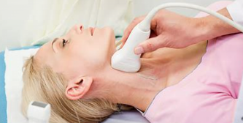
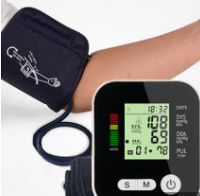
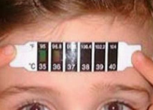
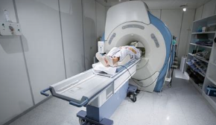
Noninvasive
Notes:
Sit on top of the skin (thermometer)
Wrap around (blood pressure cuff)

Slide 7
Let’s take a closer look…
Collection of data through noninvasive procedures (not involving general anesthesia or sedation) routinely employed in clinical practice, excluding procedures involving x-rays or microwaves. Where medical devices are employed, they must be cleared/approved for marketing. (Studies intended to evaluate the safety and effectiveness of the medical device are not generally eligible for expedited review, including studies of cleared medical devices for new indications.)
Routinely … clinical practice = a normal, everyday procedure that is used in standard medical care.

Slide 8
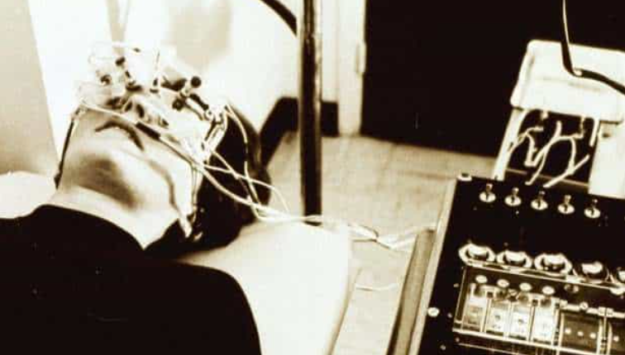
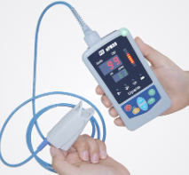
Routinely used in clinical practice
X
Notes:
Early electroretinogram – definitely not used today!!
Pulse oximeter – commonly used, even have OTC

Slide 9
Let’s take a closer look…
Collection of data through noninvasive procedures (not involving general anesthesia or sedation) routinely employed in clinical practice, excluding procedures involving x-rays or microwaves. Where medical devices are employed, they must be cleared/approved for marketing. (Studies intended to evaluate the safety and effectiveness of the medical device are not generally eligible for expedited review, including studies of cleared medical devices for new indications.)
Routinely … clinical practice = a normal, everyday procedure that is used in standard medical care. If a medical device is used, it must be cleared or approved by the FDA.

Slide 10
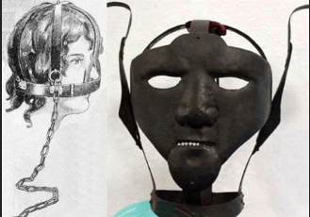
Routinely used in clinical practice
X
Notes:
Talking mask used in the middle ages to stop talkative women – not a routine modern

Slide 11
Let’s go back to a very important modifier:
Collection of data through noninvasive procedures (not involving general anesthesia or sedation) routinely employed in clinical practice, excluding procedures involving x-rays or microwaves. Where medical devices are employed, they must be cleared/approved for marketing. (Studies intended to evaluate the safety and effectiveness of the medical device are not generally eligible for expedited review, including studies of cleared medical devices for new indications.)
If the procedure requires general anesthesia or sedation, it does not meet the criteria for this category as both carry more than minimal risk.

Slide 12
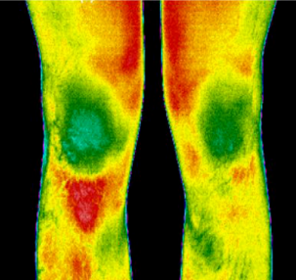
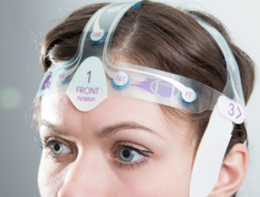
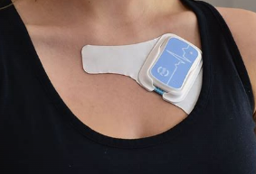
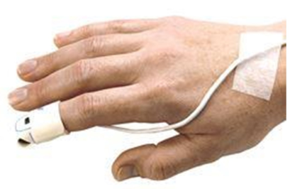
The regulations do have examples for this category – a rare treat!
physical sensors that are applied either to the surface of the body or at a distance and do not involve input of significant amounts of energy into the subject or an invasion of the subject’s privacy;
weighing or testing sensory acuity;
magnetic resonance imaging;
electrocardiography, electroencephalography, thermography, detection of naturally occurring radioactivity, electroretinography, ultrasound, diagnostic infrared imaging, doppler blood flow, and echocardiography;
moderate exercise, muscular strength testing, body composition assessment, and flexibility testing where appropriate given the age, weight, and health of the individual.
Notes:
Infrared thermography (at a distance)
Wearable electroencephalogram electrode system
Heart monitor
Pulse oximeter (around finger/toe/ear lobe)
**Important to remember that none of these pierce the skin or introduce significant energy

Slide 13
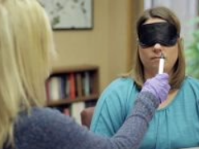
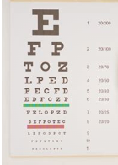
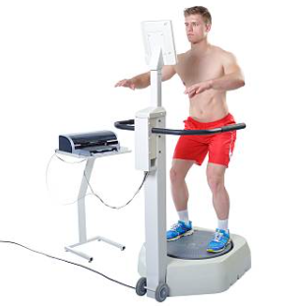
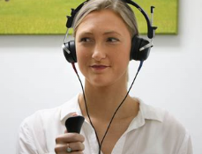
The regulations do have examples for this category – a rare treat!
physical sensors that are applied either to the surface of the body or at a distance and do not involve input of significant amounts of energy into the subject or an invasion of the subject’s privacy;
weighing or testing sensory acuity;
magnetic resonance imaging;
electrocardiography, electroencephalography, thermography, detection of naturally occurring radioactivity, electroretinography, ultrasound, diagnostic infrared imaging, doppler blood flow, and echocardiography;
moderate exercise, muscular strength testing, body composition assessment, and flexibility testing where appropriate given the age, weight, and health of the individual.
Notes:
Snedden eye chart – visual acuity
Audiometry – hearing
Balance testing – could be as simple as using a Bosu ball or a sophisticated device
Smell testing

Slide 14
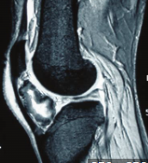
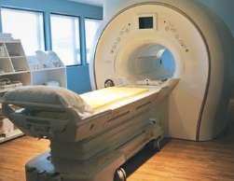
The regulations do have examples for this category – a rare treat!
physical sensors that are applied either to the surface of the body or at a distance and do not involve input of significant amounts of energy into the subject or an invasion of the subject’s privacy;
weighing or testing sensory acuity;
magnetic resonance imaging;
electrocardiography, electroencephalography, thermography, detection of naturally occurring radioactivity, electroretinography, ultrasound, diagnostic infrared imaging, doppler blood flow, and echocardiography;
moderate exercise, muscular strength testing, body composition assessment, and flexibility testing where appropriate given the age, weight, and health of the individual
MRI must be FDA-approved, i.e., 3 Tesla or lower
No use of contrast agents or sedation
Notes:
MRI uses a magnetic field to construct images

Slide 15
The regulations do have examples for this category – a rare treat!
physical sensors that are applied either to the surface of the body or at a distance and do not involve input of significant amounts of energy into the subject or an invasion of the subject’s privacy;
weighing or testing sensory acuity;
magnetic resonance imaging;
electrocardiography, electroencephalography, thermography, detection of naturally occurring radioactivity, electroretinography, ultrasound, diagnostic infrared imaging, doppler blood flow, and echocardiography;
moderate exercise, muscular strength testing, body composition assessment, and flexibility testing where appropriate given the age, weight, and health of the individual.

Slide 16
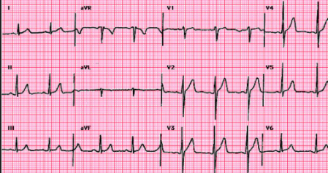
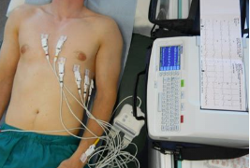
The regulations do have examples for this category – a rare treat!
physical sensors that are applied either to the surface of the body or at a distance and do not involve input of significant amounts of energy into the subject or an invasion of the subject’s privacy;
weighing or testing sensory acuity;
magnetic resonance imaging;
electrocardiography, electroencephalography, thermography, detection of naturally occurring radioactivity, electroretinography, ultrasound, diagnostic infrared imaging, doppler blood flow, and echocardiography;
moderate exercise, muscular strength testing, body composition assessment, and flexibility testing where appropriate given the age, weight, and health of the individual.
Notes:
Electrocardiogram (ECG) – measures the electrical activity of the heart.

Slide 17
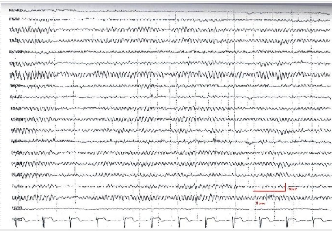
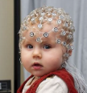
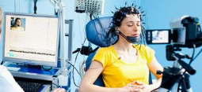
The regulations do have examples for this category – a rare treat!
physical sensors that are applied either to the surface of the body or at a distance and do not involve input of significant amounts of energy into the subject or an invasion of the subject’s privacy;
weighing or testing sensory acuity;
magnetic resonance imaging;
electrocardiography, electroencephalography, thermography, detection of naturally occurring radioactivity, electroretinography, ultrasound, diagnostic infrared imaging, doppler blood flow, and echocardiography;
moderate exercise, muscular strength testing, body composition assessment, and flexibility testing where appropriate given the age, weight, and health of the individual.

Slide 18
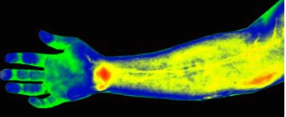
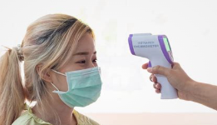
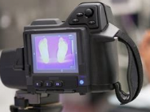
The regulations do have examples for this category – a rare treat!
physical sensors that are applied either to the surface of the body or at a distance and do not involve input of significant amounts of energy into the subject or an invasion of the subject’s privacy;
weighing or testing sensory acuity;
magnetic resonance imaging;
electrocardiography, electroencephalography, thermography, detection of naturally occurring radioactivity, electroretinography, ultrasound, diagnostic infrared imaging, doppler blood flow, and echocardiography;
moderate exercise, muscular strength testing, body composition assessment, and flexibility testing where appropriate given the age, weight, and health of the individual.

Slide 19
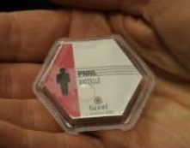
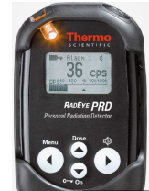
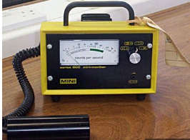
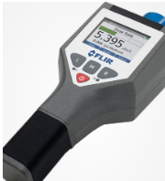
The regulations do have examples for this category – a rare treat!
physical sensors that are applied either to the surface of the body or at a distance and do not involve input of significant amounts of energy into the subject or an invasion of the subject’s privacy;
weighing or testing sensory acuity;
magnetic resonance imaging;
electrocardiography, electroencephalography, thermography, detection of naturally occurring radioactivity, electroretinography, ultrasound, diagnostic infrared imaging, doppler blood flow, and echocardiography;
moderate exercise, muscular strength testing, body composition assessment, and flexibility testing where appropriate given the age, weight, and health of the individual.

Slide 20
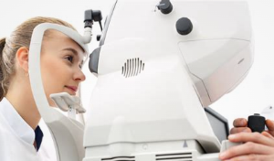
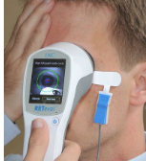
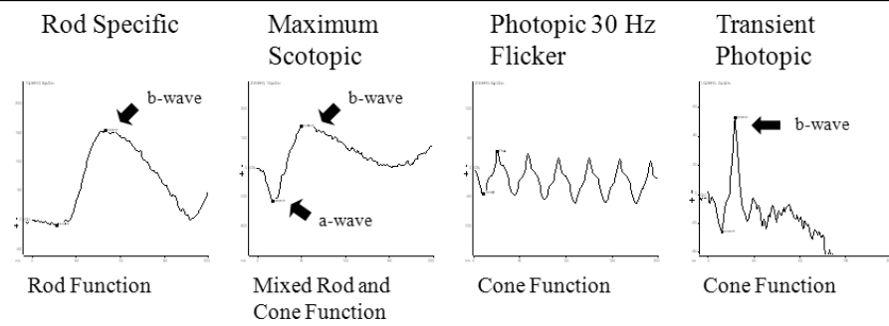
The regulations do have examples for this category – a rare treat!
physical sensors that are applied either to the surface of the body or at a distance and do not involve input of significant amounts of energy into the subject or an invasion of the subject’s privacy;
weighing or testing sensory acuity;
magnetic resonance imaging;
electrocardiography, electroencephalography, thermography, detection of naturally occurring radioactivity, electroretinography, ultrasound, diagnostic infrared imaging, doppler blood flow, and echocardiography;
moderate exercise, muscular strength testing, body composition assessment, and flexibility testing where appropriate given the age, weight, and health of the individual.
Notes:
Measures electrical activity of the cells in the retina – used to detect retinal disease
The device may be handheld or stationary.

Slide 21
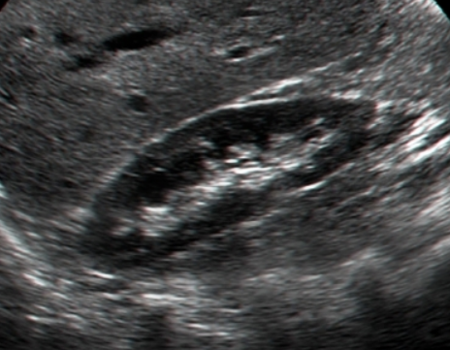
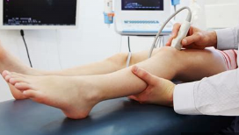
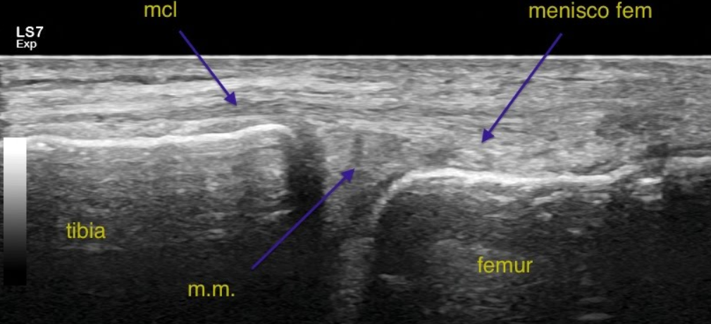
The regulations do have examples for this category – a rare treat!
physical sensors that are applied either to the surface of the body or at a distance and do not involve input of significant amounts of energy into the subject or an invasion of the subject’s privacy;
weighing or testing sensory acuity;
magnetic resonance imaging;
electrocardiography, electroencephalography, thermography, detection of naturally occurring radioactivity, electroretinography, ultrasound, diagnostic infrared imaging, doppler blood flow, and echocardiography;
moderate exercise, muscular strength testing, body composition assessment, and flexibility testing where appropriate given the age, weight, and health of the individual.
Notes:
Ultrasound uses sound waves to construct images. Used more widely than just for pregnancies! Knees, lungs, kidneys are just some examples.

Slide 22
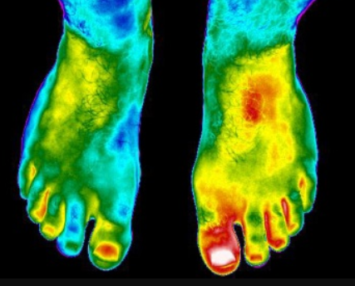
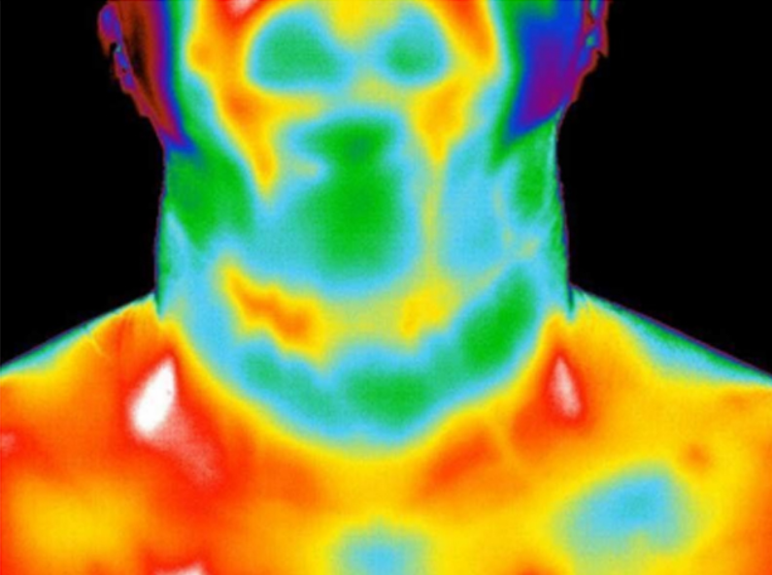
The regulations do have examples for this category – a rare treat!
physical sensors that are applied either to the surface of the body or at a distance and do not involve input of significant amounts of energy into the subject or an invasion of the subject’s privacy;
weighing or testing sensory acuity;
magnetic resonance imaging;
electrocardiography, electroencephalography, thermography, detection of naturally occurring radioactivity, electroretinography, ultrasound, diagnostic infrared imaging, doppler blood flow, and echocardiography;
moderate exercise, muscular strength testing, body composition assessment, and flexibility testing where appropriate given the age, weight, and health of the individual.
Notes:
Similar to thermography, but used to detect physiologic differences that require further investigation and to monitor healing progress.
Hypothyroidism, bursitis

Slide 23
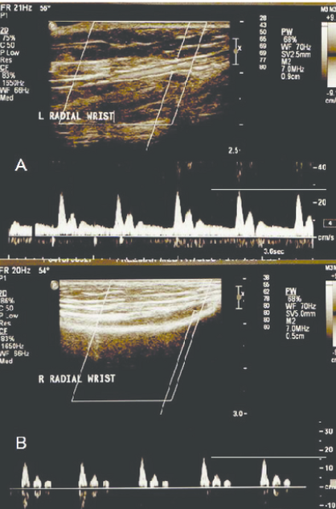
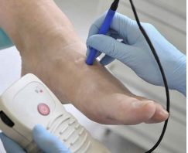
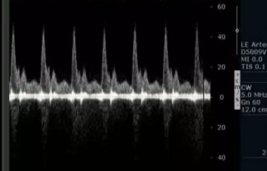
The regulations do have examples for this category – a rare treat!
physical sensors that are applied either to the surface of the body or at a distance and do not involve input of significant amounts of energy into the subject or an invasion of the subject’s privacy;
weighing or testing sensory acuity;
magnetic resonance imaging;
electrocardiography, electroencephalography, thermography, detection of naturally occurring radioactivity, electroretinography, ultrasound, diagnostic infrared imaging, doppler blood flow, and echocardiography;
moderate exercise, muscular strength testing, body composition assessment, and flexibility testing where appropriate given the age, weight, and health of the individual.
Color doppler
Pulse wave doppler
Continuous wave doppler

Slide 24
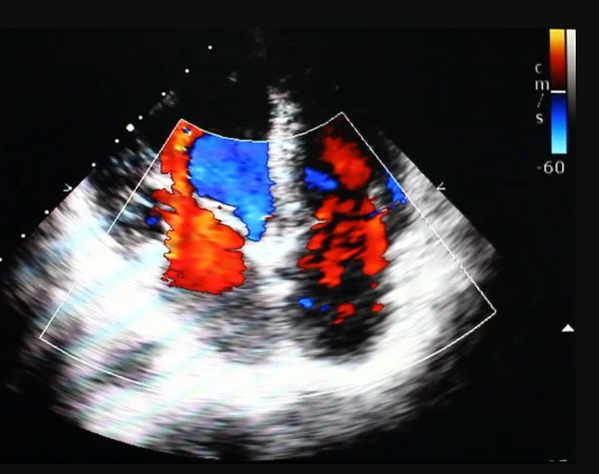
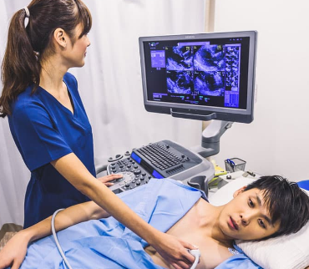
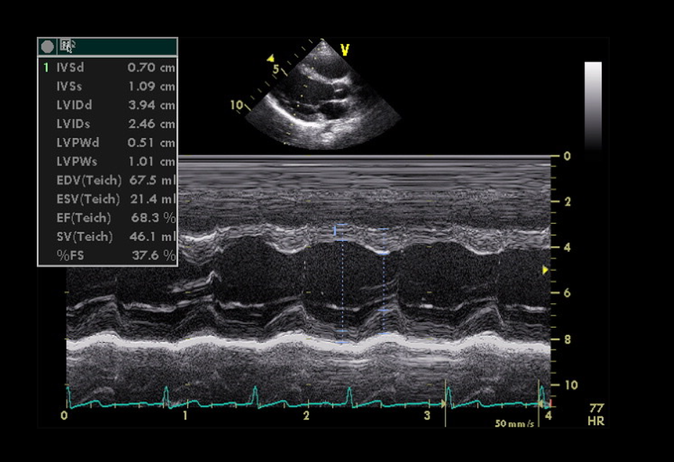
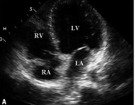
The regulations do have examples for this category – a rare treat!
physical sensors that are applied either to the surface of the body or at a distance and do not involve input of significant amounts of energy into the subject or an invasion of the subject’s privacy;
weighing or testing sensory acuity;
magnetic resonance imaging;
electrocardiography, electroencephalography, thermography, detection of naturally occurring radioactivity, electroretinography, ultrasound, diagnostic infrared imaging, doppler blood flow, and echocardiography;
moderate exercise, muscular strength testing, body composition assessment, and flexibility testing where appropriate given the age, weight, and health of the individual.
Notes:
Uses ultrasound to study the structure and motion of the heart

Slide 25
The regulations do have examples for this category – a rare treat!
physical sensors that are applied either to the surface of the body or at a distance and do not involve input of significant amounts of energy into the subject or an invasion of the subject’s privacy;
weighing or testing sensory acuity;
magnetic resonance imaging;
electrocardiography, electroencephalography, thermography, detection of naturally occurring radioactivity, electroretinography, ultrasound, diagnostic infrared imaging, doppler blood flow, and echocardiography;
moderate exercise, muscular strength testing, body composition assessment, and flexibility testing where appropriate given the age, weight, and health of the individual.
CDC: Moderate-intensity Exercise (64% - 74% maximum heart rate)
Walking 3 mph or faster (but not race-walking)
Biking 10 mph on flat or level terrain
High-intensity Exercise (77% - 93% maximum heart rate)
Race walking, jogging, running
Swimming laps
Biking 10 mph+ with hills
Notes:
Most Exercise and Sport Science studies will include the target heart rate in their exercise parameters

Slide 26
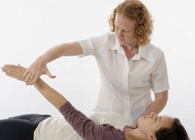
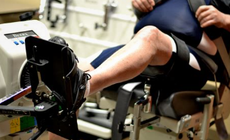
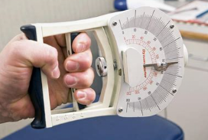
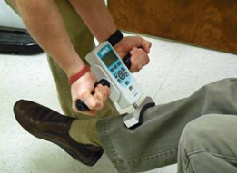
The regulations do have examples for this category – a rare treat!
physical sensors that are applied either to the surface of the body or at a distance and do not involve input of significant amounts of energy into the subject or an invasion of the subject’s privacy;
weighing or testing sensory acuity;
magnetic resonance imaging;
electrocardiography, electroencephalography, thermography, detection of naturally occurring radioactivity, electroretinography, ultrasound, diagnostic infrared imaging, doppler blood flow, and echocardiography;
moderate exercise, muscular strength testing, body composition assessment, and flexibility testing where appropriate given the age, weight, and health of the individual.
Notes:
Muscle strength testing can be done using a device or manually

Slide 27
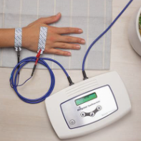
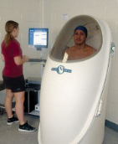
The regulations do have examples for this category – a rare treat!
physical sensors that are applied either to the surface of the body or at a distance and do not involve input of significant amounts of energy into the subject or an invasion of the subject’s privacy;
weighing or testing sensory acuity;
magnetic resonance imaging;
electrocardiography, electroencephalography, thermography, detection of naturally occurring radioactivity, electroretinography, ultrasound, diagnostic infrared imaging, doppler blood flow, and echocardiography;
moderate exercise, muscular strength testing, body composition assessment, and flexibility testing where appropriate given the age, weight, and health of the individual.
Estimate the percentage of fat, muscle, bone, water, skin:
Skinfold
Body circumference measurement
Hydrostatic weighing
Bioimpedance analysis
Bodpod
MRI
Two other procedures do not meet expedited criteria due to the use of radiation:
DEXA
CT

Slide 28
The regulations do have examples for this category – a rare treat!
physical sensors that are applied either to the surface of the body or at a distance and do not involve input of significant amounts of energy into the subject or an invasion of the subject’s privacy;
weighing or testing sensory acuity;
magnetic resonance imaging;
electrocardiography, electroencephalography, thermography, detection of naturally occurring radioactivity, electroretinography, ultrasound, diagnostic infrared imaging, doppler blood flow, and echocardiography;
moderate exercise, muscular strength testing, body composition assessment, and flexibility testing where appropriate given the age, weight, and health of the individual.

Slide 29
The regulations do have examples for this category – a rare treat!
physical sensors that are applied either to the surface of the body or at a distance and do not involve input of significant amounts of energy into the subject or an invasion of the subject’s privacy;
weighing or testing sensory acuity;
magnetic resonance imaging;
electrocardiography, electroencephalography, thermography, detection of naturally occurring radioactivity, electroretinography, ultrasound, diagnostic infrared imaging, doppler blood flow, and echocardiography;
moderate exercise, muscular strength testing, body composition assessment, and flexibility testing where appropriate given the age, weight, and health of the individual.
Always consider the population that is being tested when exercise, muscular strength, and flexibility testing are included in the study population.
“Health” may also include otherwise healthy individuals who are recovering from an injury and/or surgery.

Slide 31
First example: Does this fit into Category 4?
A researcher plans to measure the average number of steps per day that triathletes take compared to adults who exercise moderately. Participants must be adults competent to consent and in good physical health in order to participate. The researcher gives each of her participants a pedometer that can be worn around the wrist or ankle at their discretion. The pedometer that she chooses is commonly used in clinical practice and has been vetted by the United States Food and Drug Administration (FDA). Each participant will wear the pedometer every day for one week, taking it off when they sleep, bathe, or shower.
Yes, this study would meet the requirements for Expedited Category 4, as the pedometer is both “non-invasive” and has been approved by the FDA.

Slide 32
First example: Does this fit into Category 4?
A researcher is interested in examining the parts of the brain that are associated with affection and social relationships in high-functioning adults with Autism Spectrum Disorder (ASD). The researcher will show participants pictures and videos of their loved ones while using fMRI to map their brain patterns. The researcher plans to recruit adult patients diagnosed with ASD and a control sample of neurotypical adults. The researcher will not require a formal diagnosis of ASD in order to be eligible for the study, only self-report.
Yes, this study would meet the requirements for Expedited Category 4, as fMRI is both “non-invasive” and has been approved by the FDA.

Slide 33
First example: Does this fit into Category 4?
A researcher is interested in examining the structures of the brain in infants and toddlers to understand the changes early in life. The researcher will recruit in local OB-GYN and pediatric clinics. Since the child must be still during the MRI, the infant will be mildly sedated.
No, this study would not meet the requirements for Expedited Category 4. Although MRI is both “non-invasive” and has been approved by the FDA, the use of sedation is excluded from this category.

Slide 34
What expedited categories fit this study?
A researcher is interested in examining how exercise affects blood glucose levels in sedentary adults with Type 2 Diabetes. The participants will monitor their blood glucose using their personal glucometer as they would normally would, but they will record the measurements on a study log along with their daily diet over a two-week period. For the exercise intervention, they will walk each day for 15 minutes at a pace that is comfortable for them.

Slide 35
What expedited categories fit this study?
A researcher is interested in examining how exercise affects blood glucose levels in sedentary adults with Type 2 Diabetes. The participants will monitor their blood glucose using their personal glucometer as they would normally would, but they will record the measurements on a study log along with their daily diet over a two-week period. For the exercise intervention, they will walk each day for 15 minutes at a pace that is comfortable for them.
Measurement of blood glucose – Category 2
Recording glucose readings and diet – Category 7
Moderate exercise - Category 4

Slide 36
What expedited categories fit this study?
A researcher is interested in examining the parts of the brain that are associated with processing music in a longitudinal study to look for changes in the brain during the aging process. The researcher will recruit adult participants aged 35-45 with no neurological deficits to listen to different music genres and sing along while using fMRI to map their brain patterns. The participants will complete a demographic questionnaire and a complete medical history form at baseline as well as provide blood and saliva samples and a physical exam including height, weight, blood pressure, and pulse rate. At each follow-up, they will complete a medical history update form and provide blood and saliva samples.

Slide 37
What expedited categories fit this study?
A researcher is interested in examining the parts of the brain that are associated with processing music in a longitudinal study to look for changes in the brain during the aging process. The researcher will recruit adult participants aged 35-45 with no neurological deficits to listen to different music genres and sing along while using fMRI to map their brain patterns. The participants will complete a demographic questionnaire and a complete medical history form at baseline as well as provide blood and saliva samples and a physical exam including height, weight, blood pressure, and pulse rate and the fMRI. At each follow-up, they will complete a medical history update form, provide blood and saliva samples, a physical exam and fMRI.
Questionnaires – Category 7
Saliva sample – Category 3
Blood samples – Category 2
Physical exam, MRI – Category 4

Slide 38
References
Institutional Review Board: Management and Function
Code of Federal Regulations: 45 CFR 46 – Protection of Human Subjects
https://www.ecfr.gov/on/2018-07-19/title-45/subtitle-A/subchapter-A/part-46

